Slide 1

Market segmentation
Problem
Model Selection/Performance
Conclusions
Yanxi Li
12/16/2020

Slide 2
Project problem
Before
Model based on Demographic information
Now
Model based on a, Purchase behavior
b, Basis of purchase
c, both a & b
How to associate demographic with a/b/c to find the successful segmentation?

Slide 3
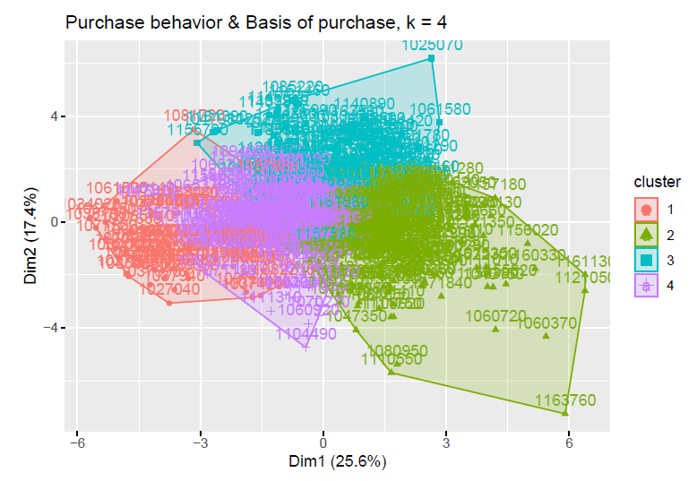
Model Selection/Performance
K-means
Model built on c method :
Purchase behavior & Basis of purchase
numbers of cluster k = 4
Cluster 1 * is the target segment
low socioeconomics
low education level
low affluence index
more number of people
highest brand loyalty
Successful Segment

Slide 4
Conclusions
Our promising group is cluster 1 which have low socioeconomics, low education level, low affluence index, more people, and highest brand loyalty.
Since it has the highest brand loyalty, so the company should build more promotion strategies to them.

